Slide 1

Optimization on deep learning
MATH818 Research in Applied math
2019020356 Jaeheun Jung

Slide 2
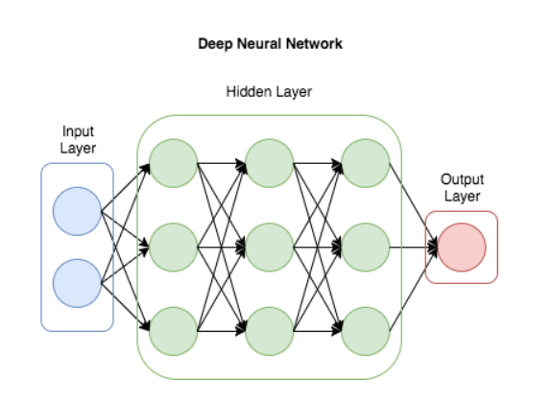
DNN Architecture
Universal function approximator
Combination of weighted sum and activation
Parametrized with matrices

Slide 3
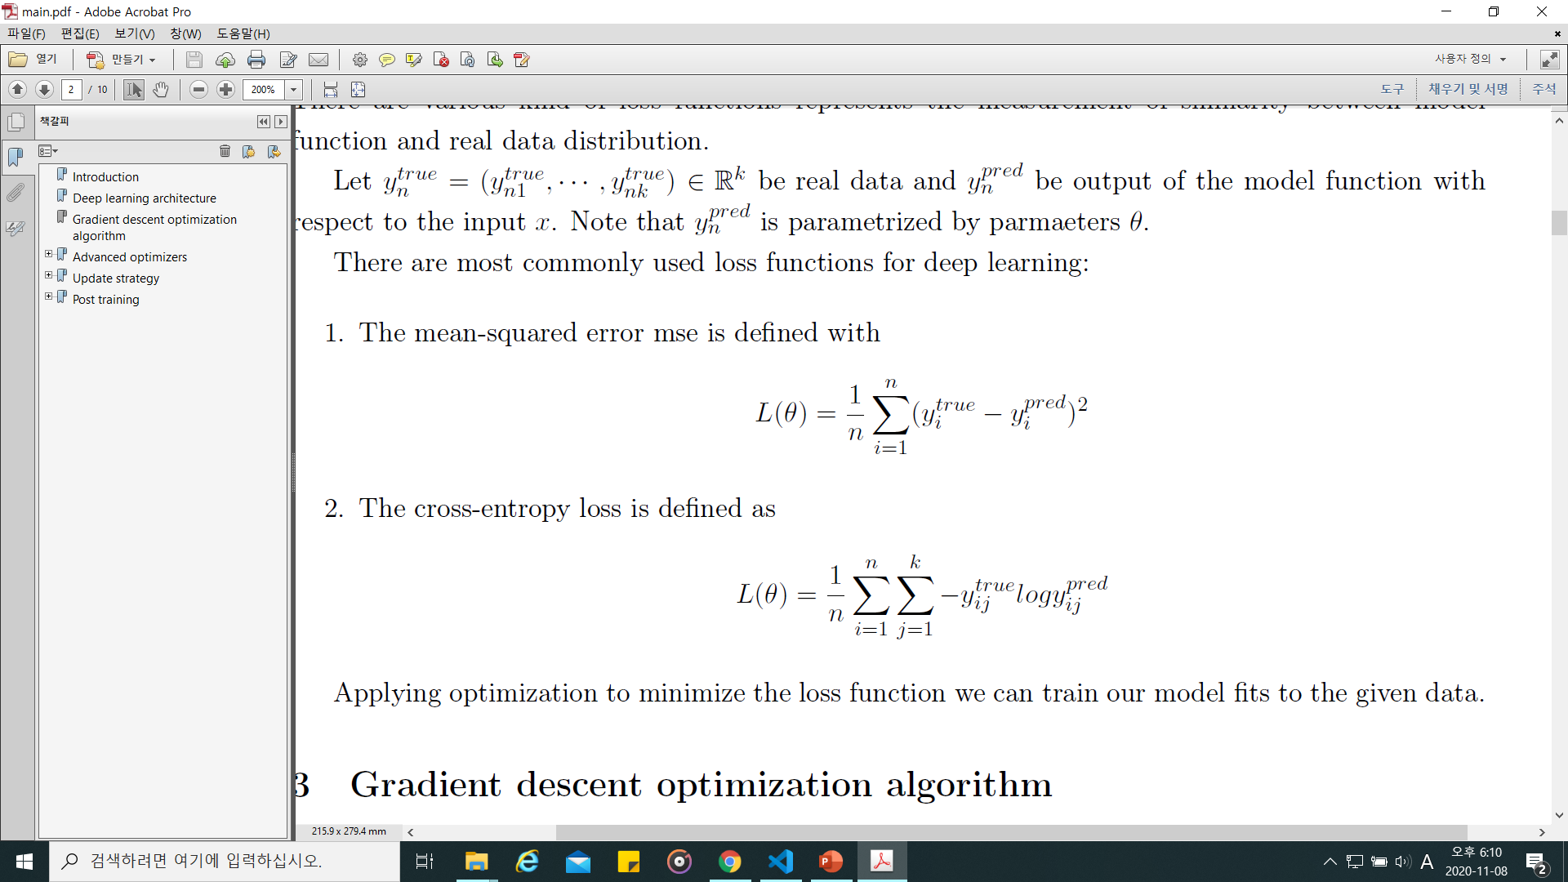
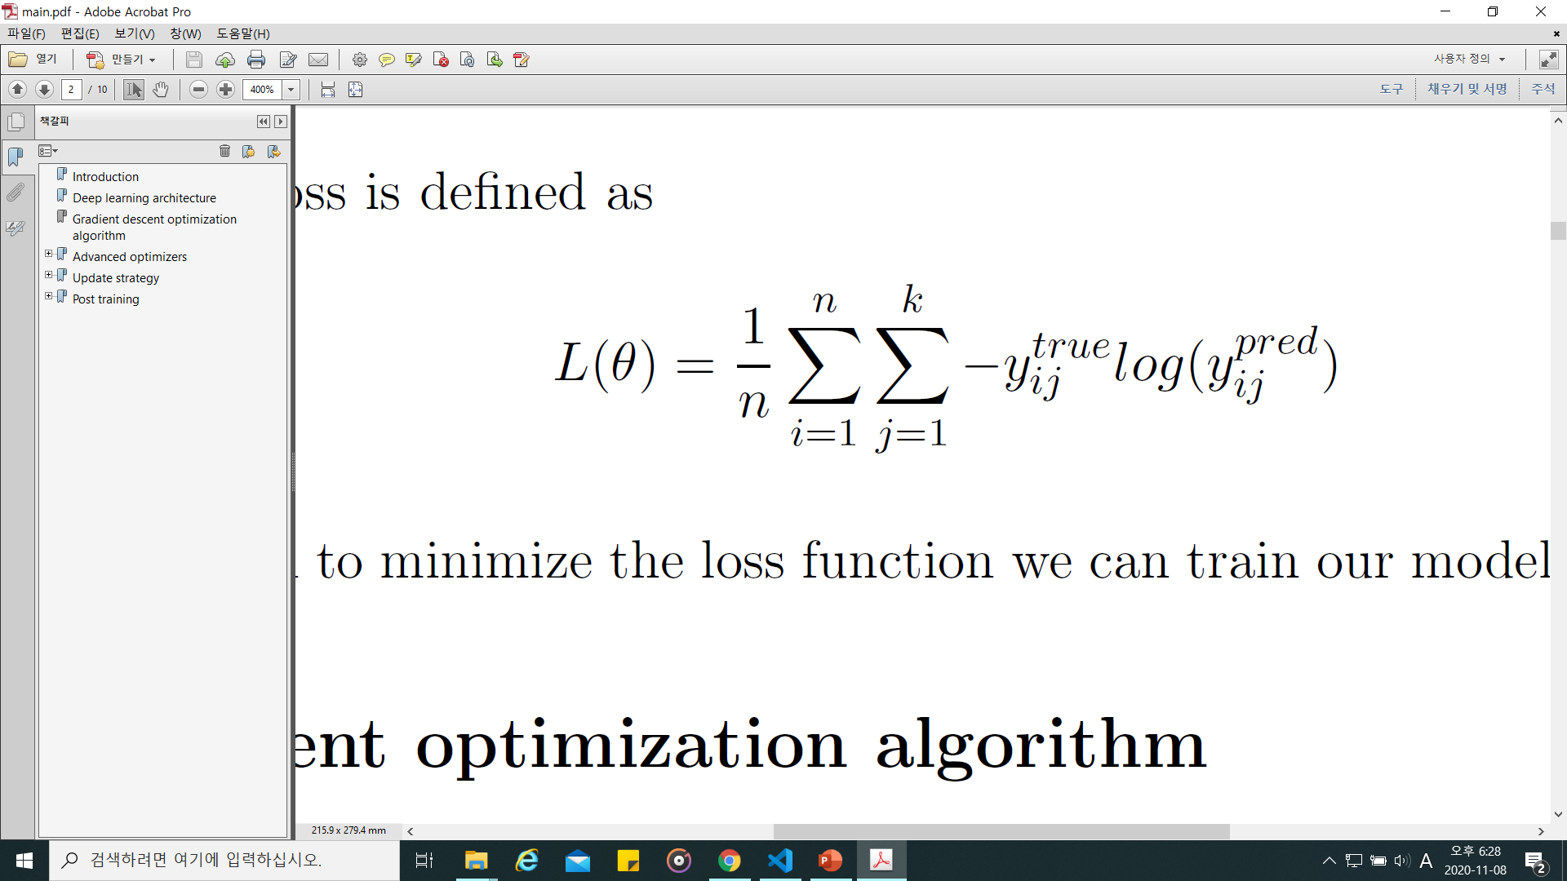
Loss function
Measurement for the difference between model and real data
MSE loss (Mean-Squared Error)
Cross-entropy loss

Slide 4
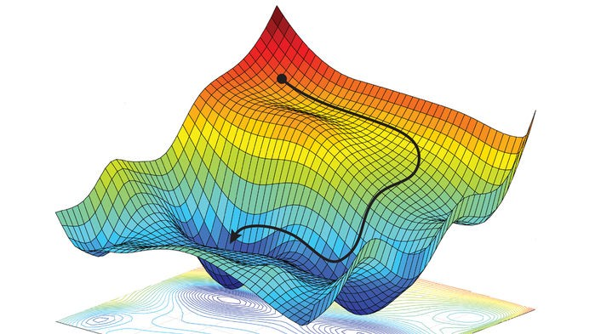

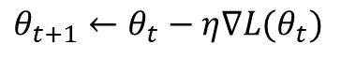
Gradient descent
First-order iterative optimization
$$θ_{t+1}←θ_{t}−η∇L(θ_{t})$$

Slide 5
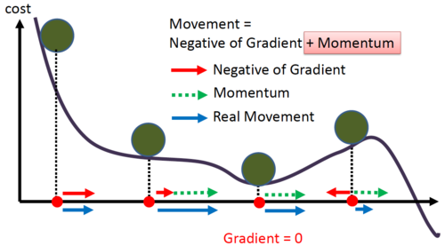
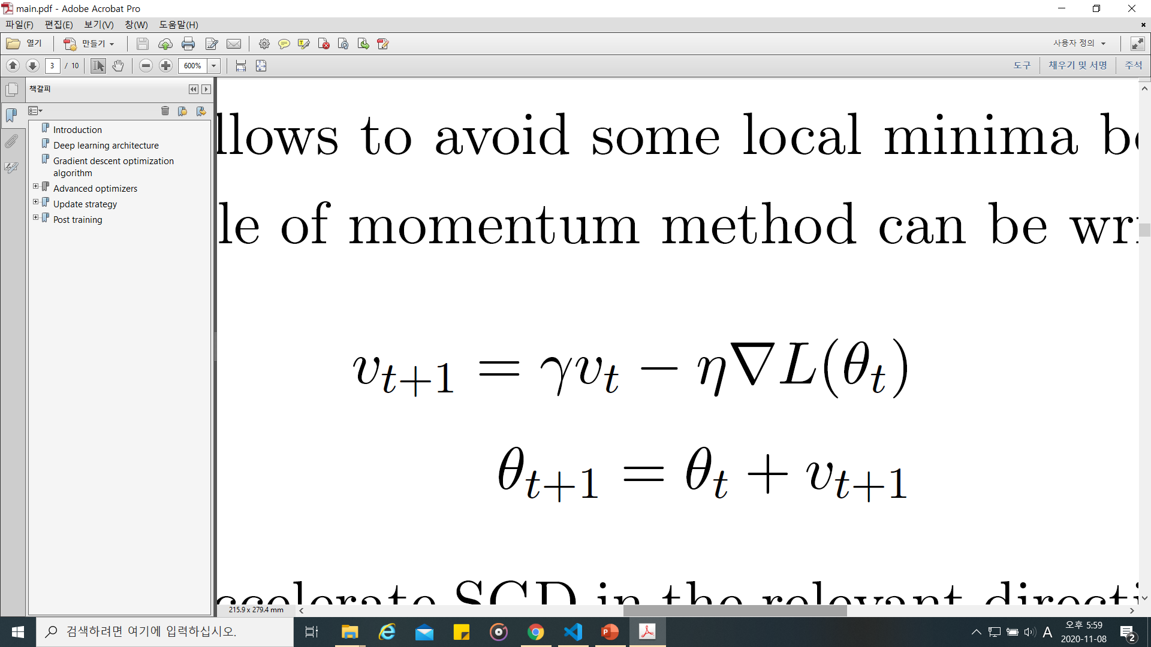
Optimizers
Momentum

Slide 6
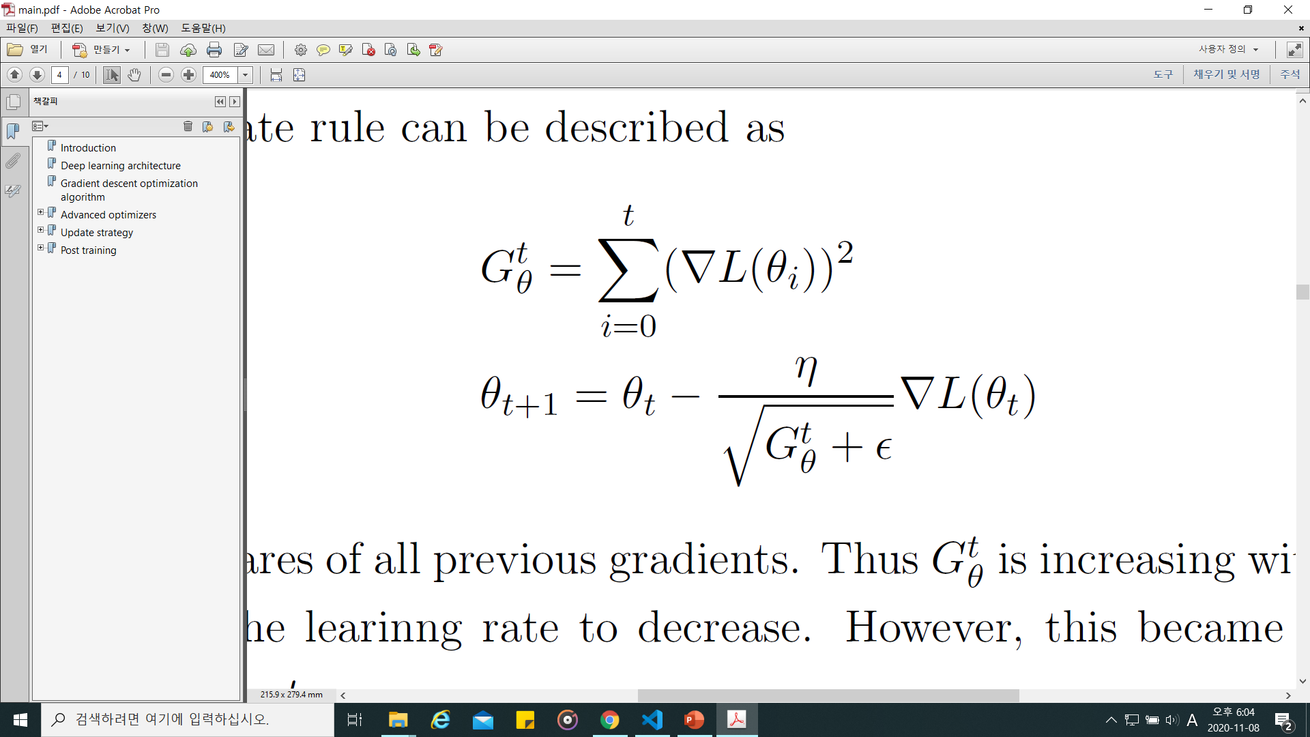
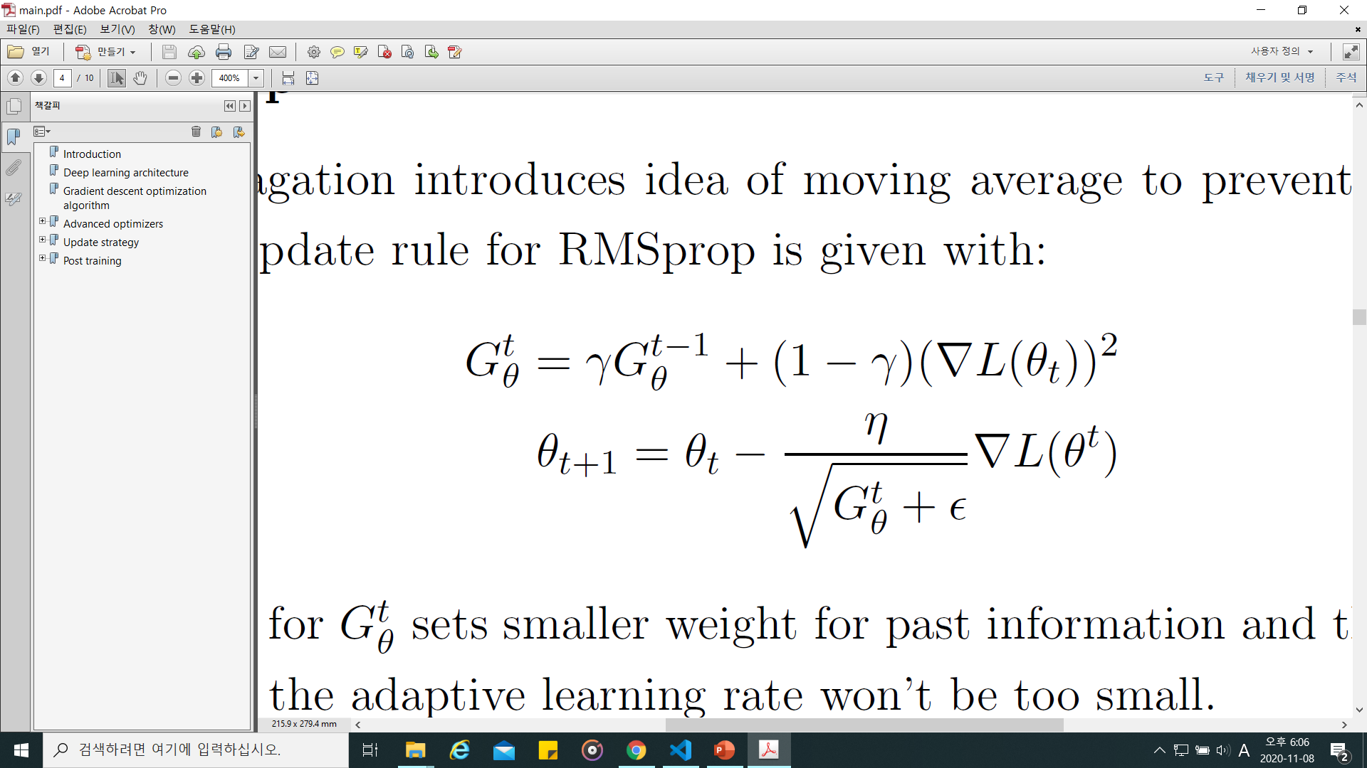
optimizers
Adaptive learning rate
Adagrad
RMSprop

Slide 7
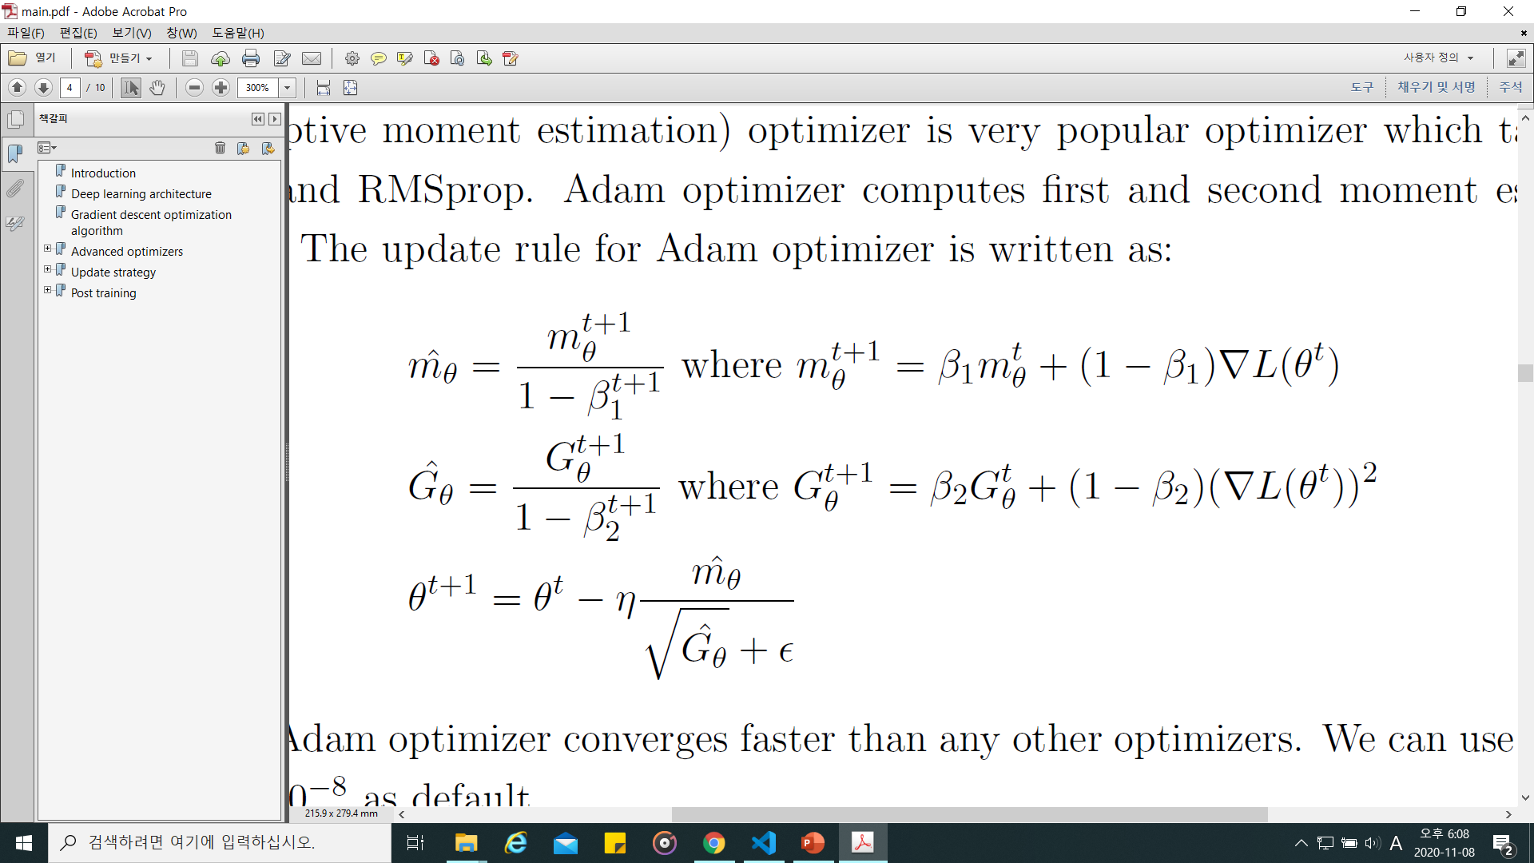
optmimizers
Adam

Slide 8
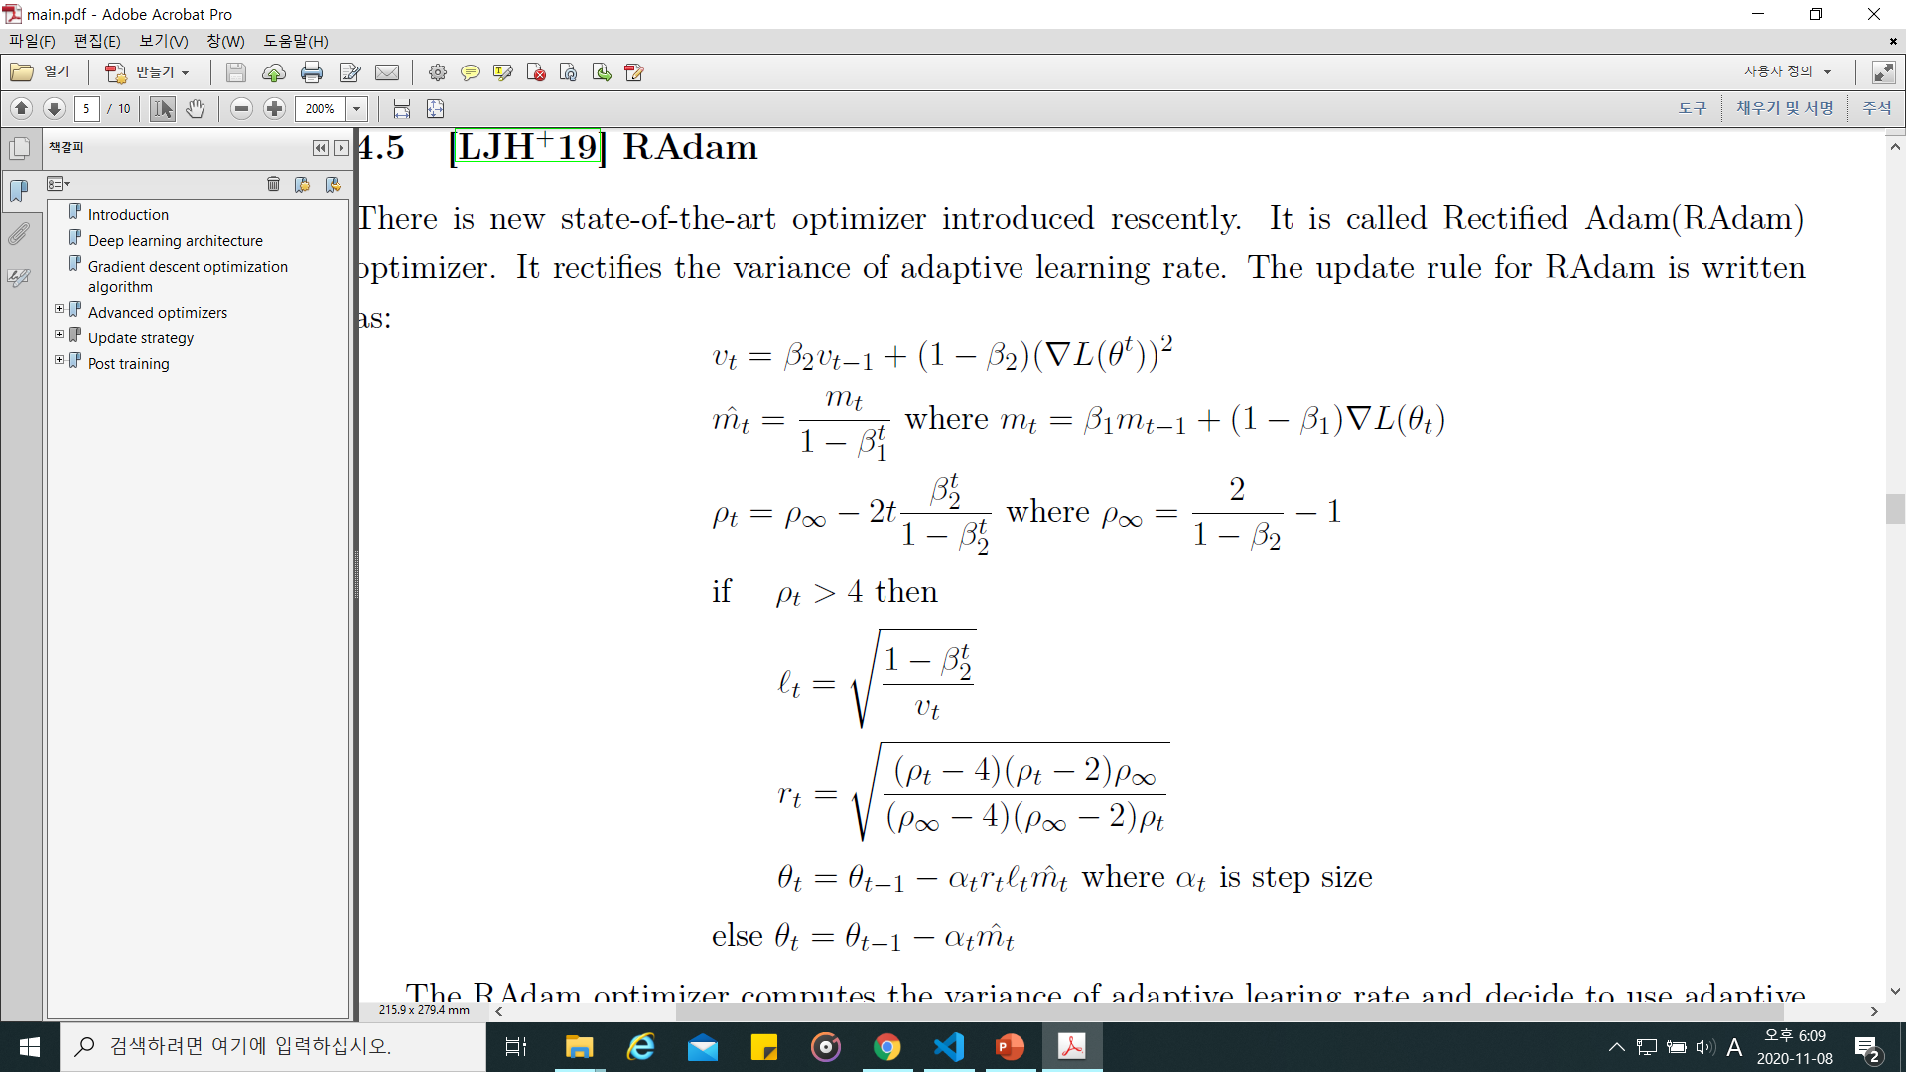
Optimizers
RAdam

Slide 9
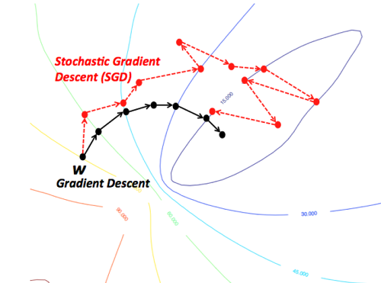
Batch size
# of datapoints for single update
Stochastic Gradient descent
Single datapoint
Batch Gradient descent
All datapoints

Slide 10
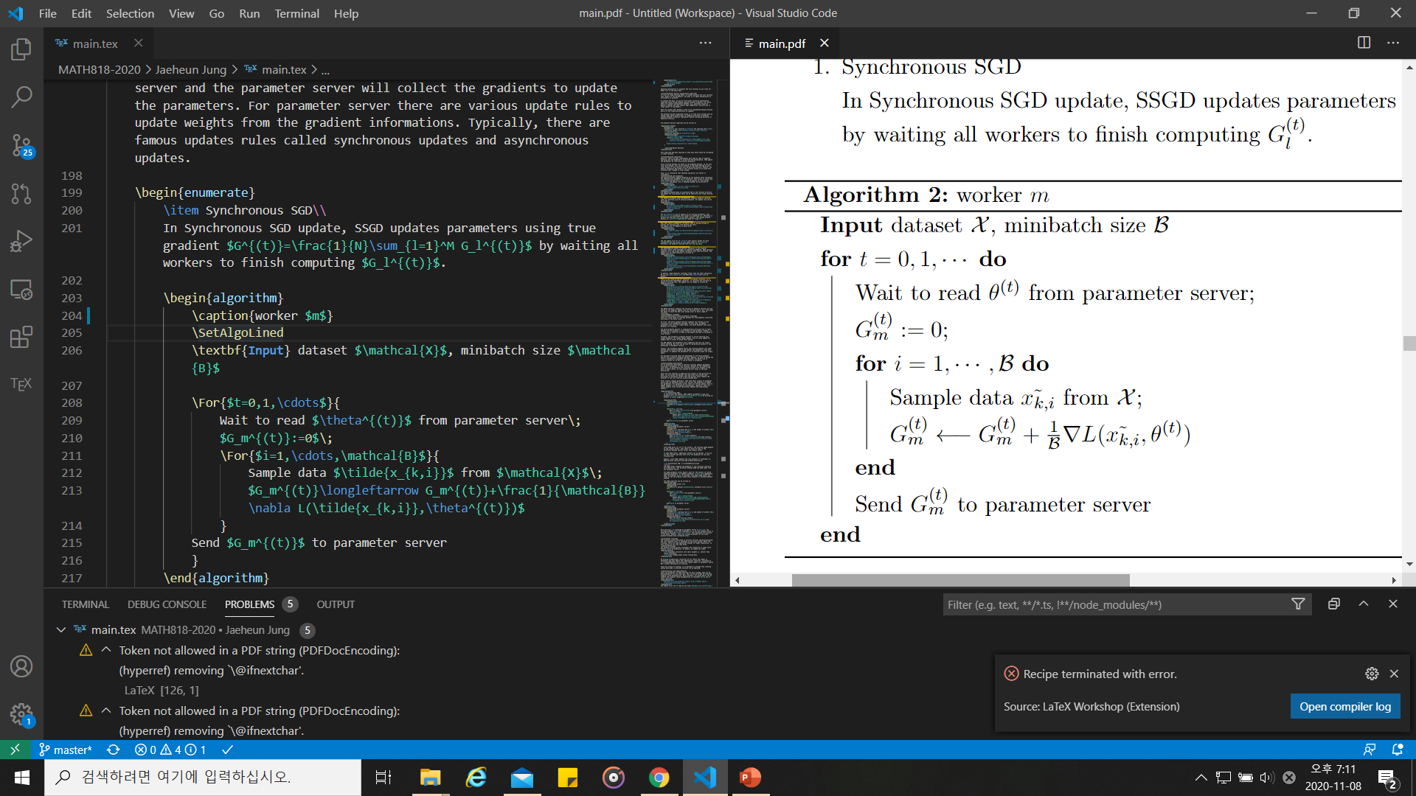
Data parallelism
Multiple workers compute gradient
Parameter server collects gradients and update the parameter
Update Rules:
SSGD and ASGD

Slide 11
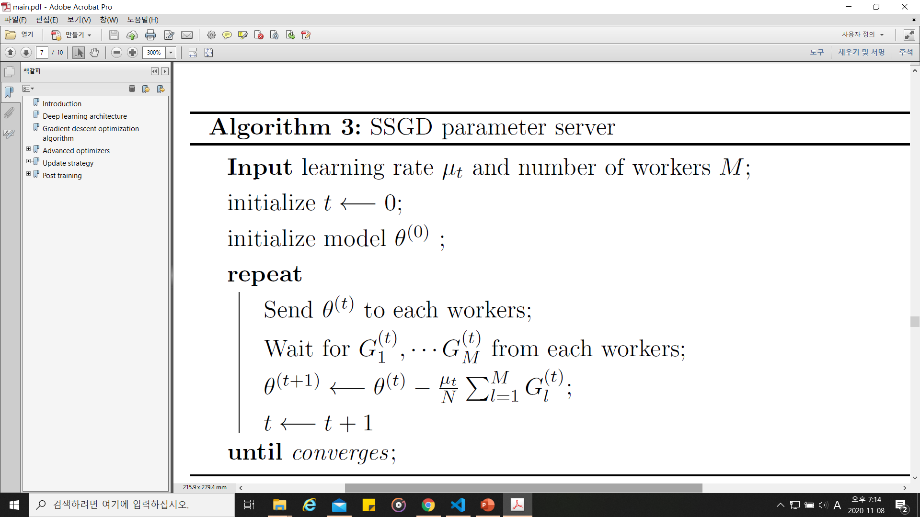
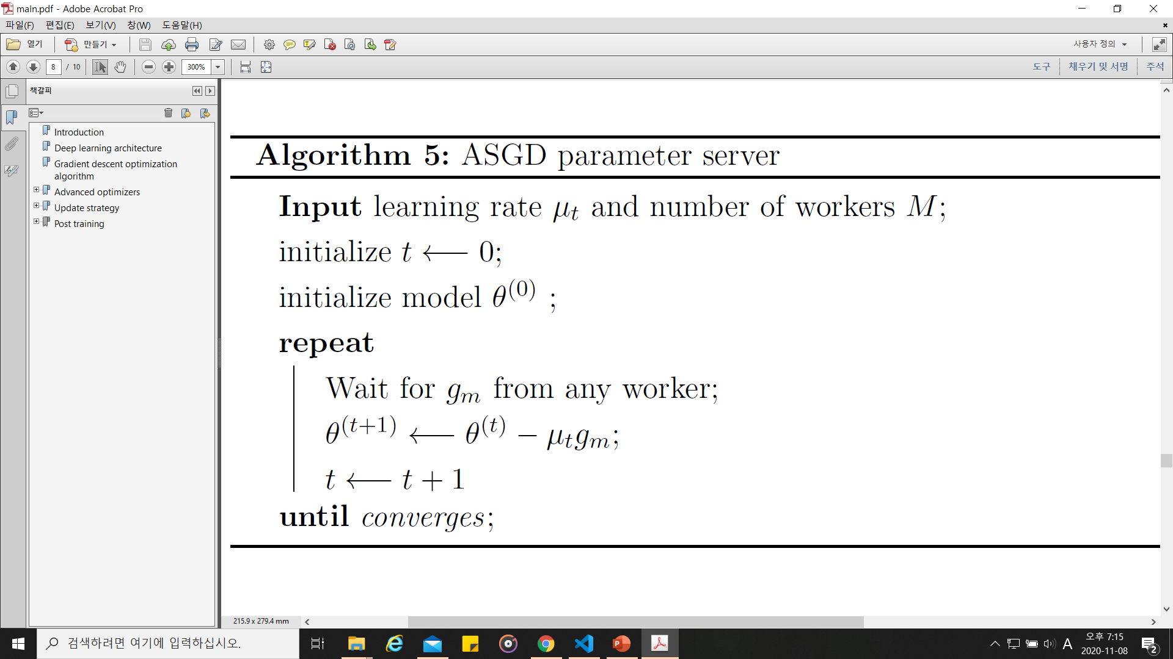
Data parallelism
Synchronous update
Asynchronous update

Slide 12
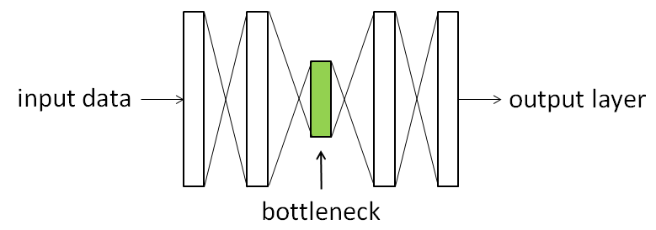
Matrix rank constraint

Slide 13
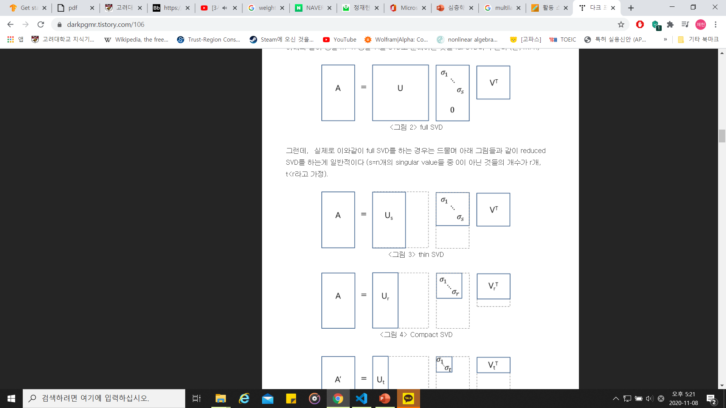
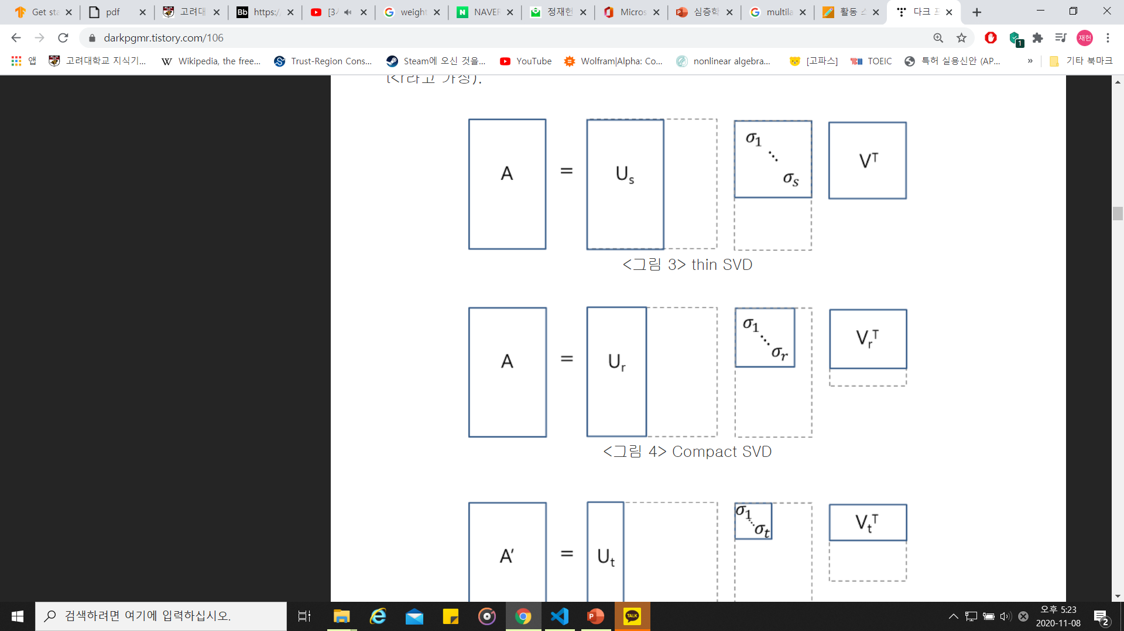
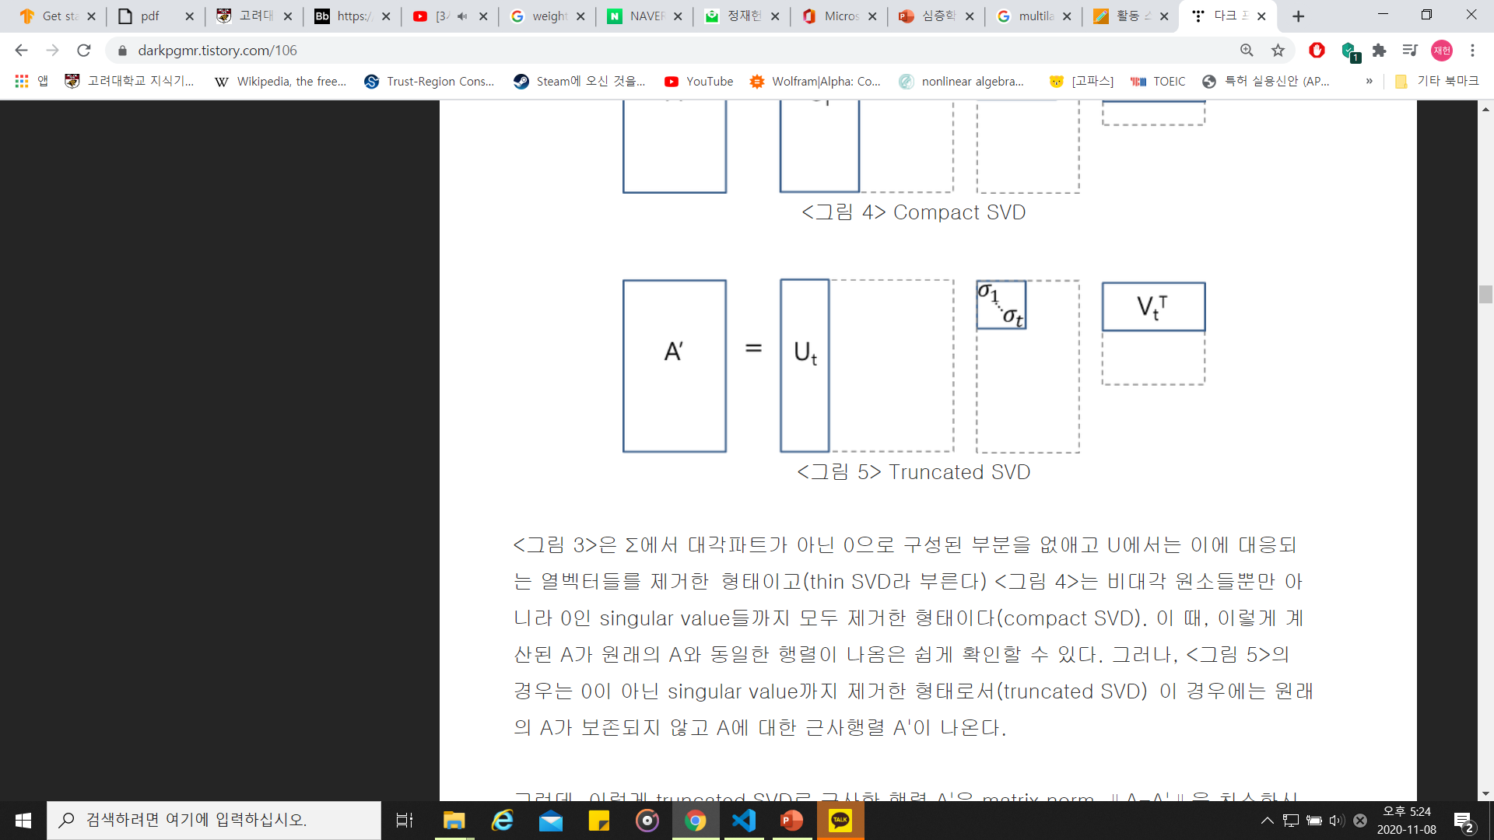
Truncated svd
Full SVD
Thin SVD
Truncated SVD
Compact SVD

Slide 14


Truncated SVD
Original image: rank 402
Truncated svd: rank 80

Slide 15
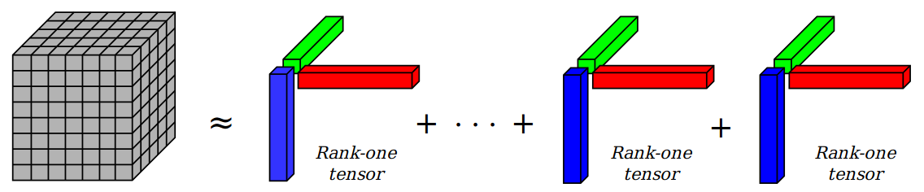
Canonical Polyadic decomposition
Weight for Convolutional layer: 4-tensor
# of parameters:${ T}_{1}T_{2}T_{3}T_{4}→R(T_{1}+T_{2}+T_{3}+T_{4})$

Slide 16
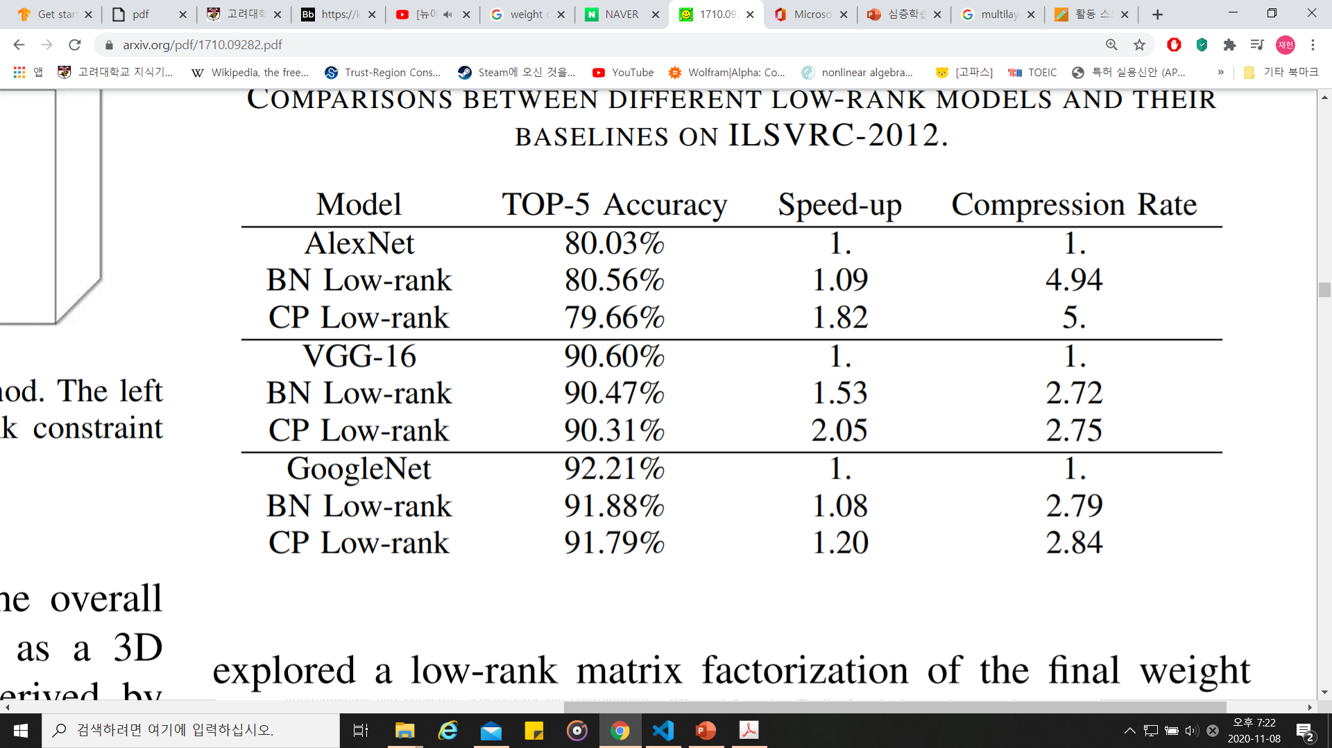
Low rank approximation

